Slide 1
Emerging Wireless Technologies

Slide 2
Different emerging wireless technologies
Wireless Fidelity (WiFi) – More standards for faster communication.
Light Fidelity (LiFi) ,
Gigabit Wireless (GiFi),
Bluetooth, (BLE)
WiMAX,
ZigBee
RFID Technology.
Terabit Satellite
Millimeter Wave
Passive WiFi
Ultra-Wideband
Low Power Wide Area Network (LPWA)

Slide 3
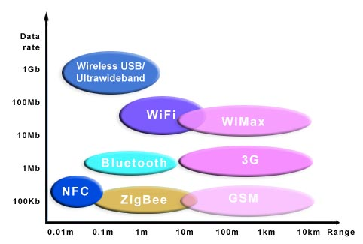
Range vs Data Rate

Slide 4
WHAT IS LI-FI?
Li-Fi, as coined by Prof. Harald Haas during his TED Global talk, is bidirectional, high speed and fully networked wireless communications similar to Wi-Fi.
Li-Fi is a subset of optical wireless communication (OWC) and can be a complement to RF communication (Wi-Fi or Cellular network), or a replacement in contexts of data broadcasting.

Slide 5
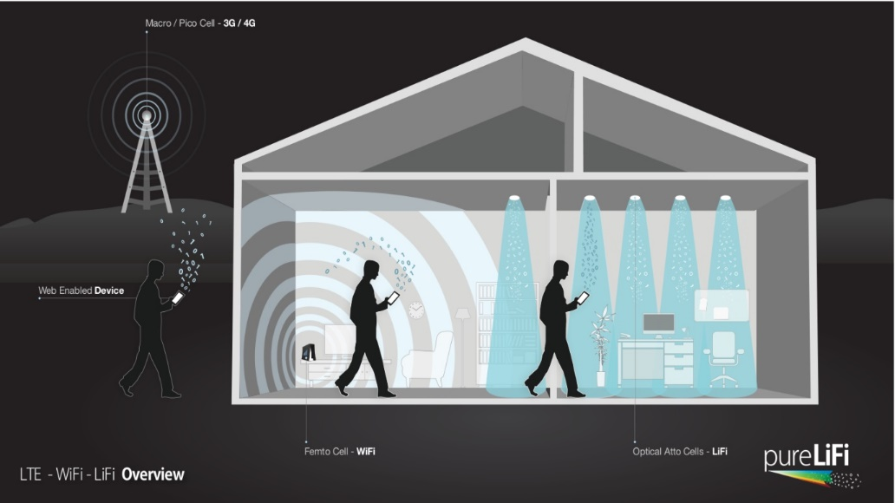
Existing wireless technology - Why do we need an alternate technology?
CAPACITY
EFFICIENCY
AVAILABILITY
SECURITY

Slide 6
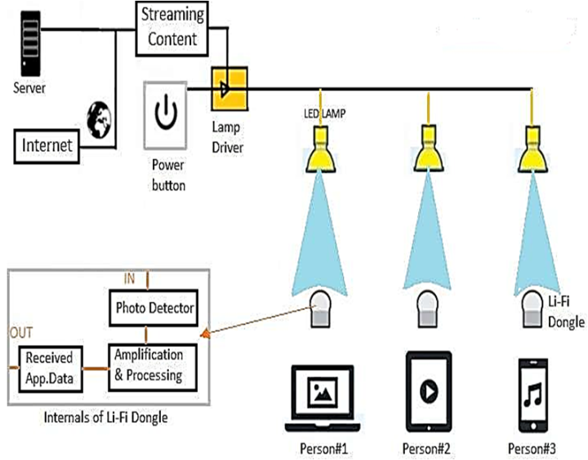
WORKING

Slide 7
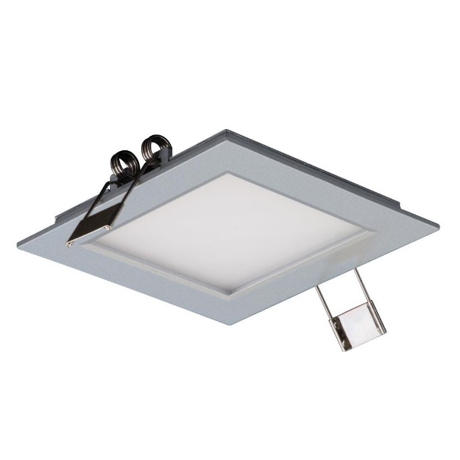

Transmitting Elements
LED
Fluorescent Lamp

Slide 8
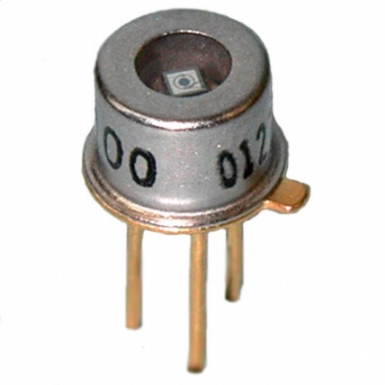
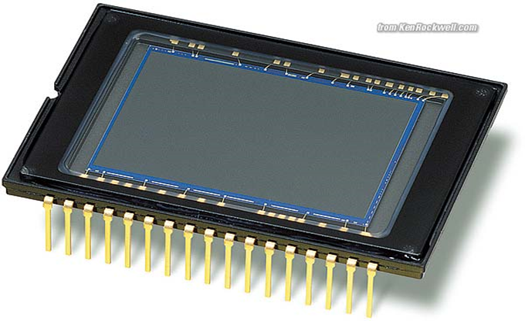
Receiving Elements
Photo Diode Image Sensor

Slide 9
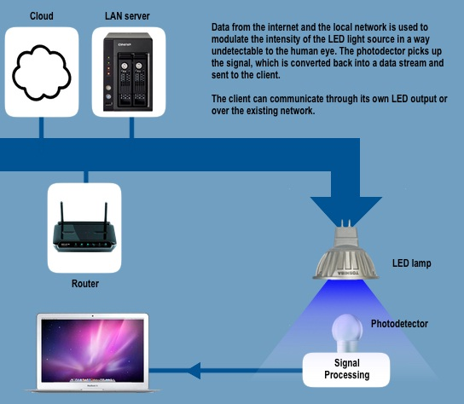
How Li Fi Works

Slide 10
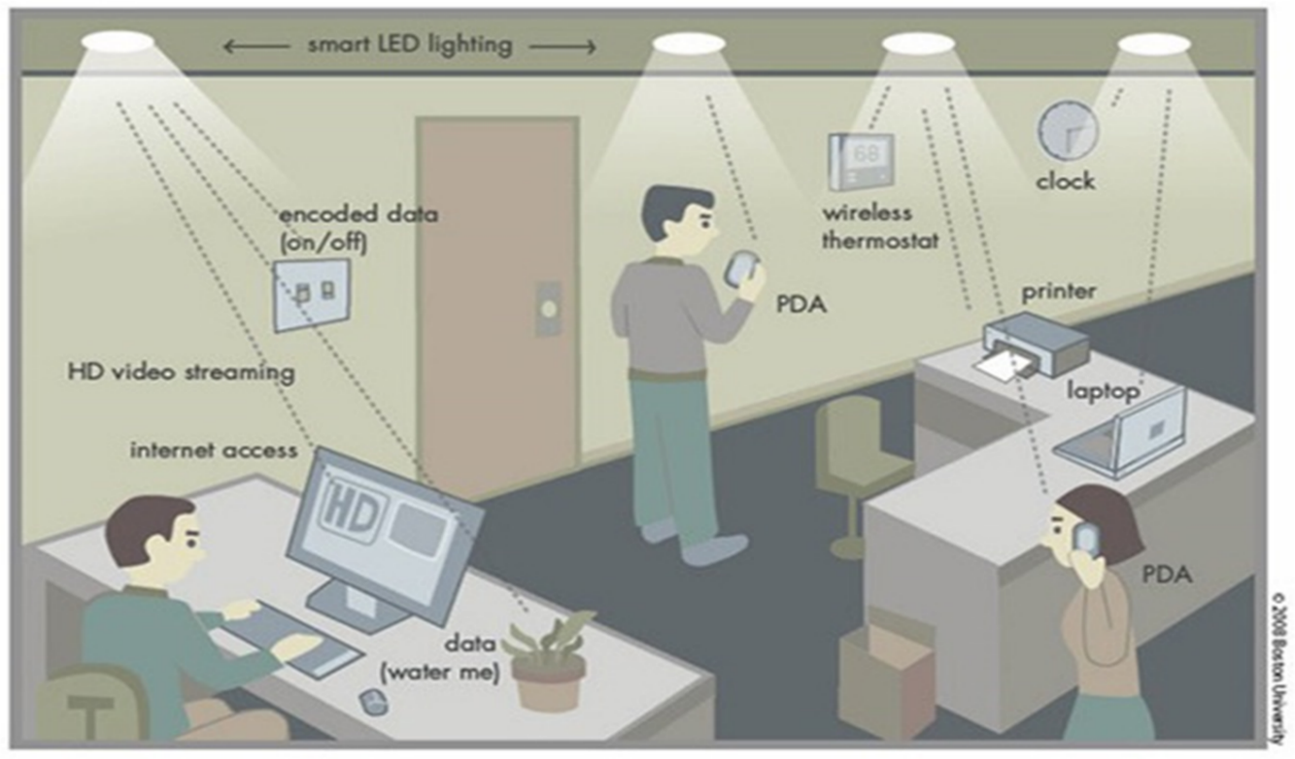
Real Time Usage of Li Fi

Slide 11
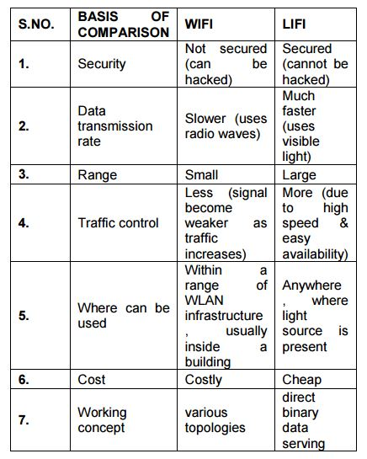
LIFI OVER WIFI

Slide 12
Comparison between Various Communication Technologies
Wired
Wireless(Current)
Wireless(Future)
Fire wire | 800 Mbps
USB 3.0 | 5 Gbps
Thunderbolt | 20 Gbps
Wi-Fi | 150 Mbps
Bluetooth | 3 Gbps
IrDA | 4 Gbps
Li-Fi | 10 Gbps
Giga-IR | 1 Gbps
Wi-Gig | 2Gbps

Slide 13
Applications of Li Fi
Airways

Slide 14
DISADVANTAGES
Nothing in this world is perfect and so does LIFI.
These signals cannot penetrate walls. So the person needs wired bulb in that room also.
Only works if there is direct line of sight between source and receiver.
Used for broadcast and it is difficult to uplink.

Slide 15
APPLICATIONS
Underwater communications: Since radio waves cannot be used under water because these waves are strongly absorbed by sea water within feet of their transmission and this renders it unusable underwater but LIFI is suitable for underwater communication
Health sector: Since WIFI is not safe to be used in hospitals and other various health care sectors because it penetrates human body. LIFI can be implemented and well suit in this sector.
Internet anywhere: street lamps, light of vehicles can be used to access internet anywhere in footpaths, roads, malls, anywhere where light source is available.
Safety and management: it can be used to update traffic information at almost every instant and it will be easy for traffic police to deal with traffic and catch the one who breaks the rule.

Slide 16
IDEAS FOR MORE APPLICATIONS :
Finding the location of a person :
LiFi uses visible light and this property can be exploited in finding the location of people. Suppose if a child is misplaced and he/she is wearing an earing which is made of Led’s. this led can constantly communicate with the visible light available and reveal the location of the child.
Navigation System : since visible light is present everywhere, we can create internal navigation systems for the bigger areas to create automated machinery/ automatic navigation for the visitors.

Slide 17
IDEAS FOR MORE APPLICATIONS :
Underwater Applications : the LEDs can be embedded in the water bed to reveal the various impurities underwater. The various leds will communicate with each other to give the overall amount of impurity in that particular area.
Instant data transfer between the devices : the high speed transfer of the leds can be used to transfer the data between the devices.
The disadvantage of the Lifi is uplink is difficult.
So we can have the photodiodes embedded near to the people on the pillars Or we can have the same led behaving as a photodiode as well as an led.

Slide 18
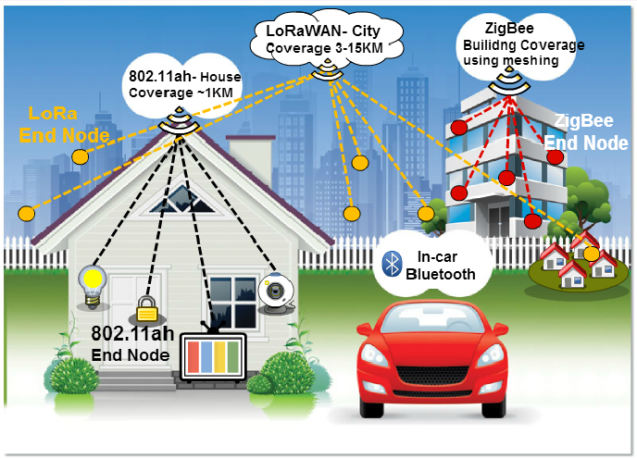
Wireless Technologies in IoT

Slide 19
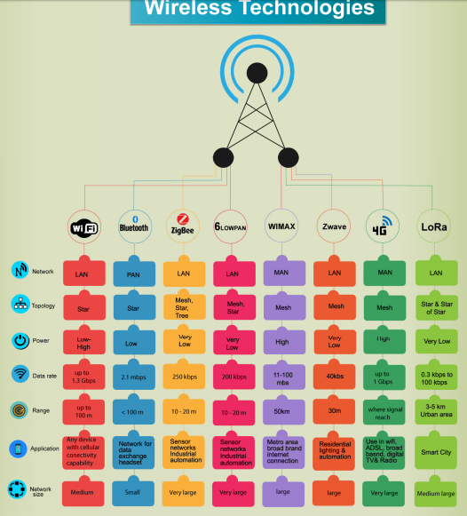

Slide 20
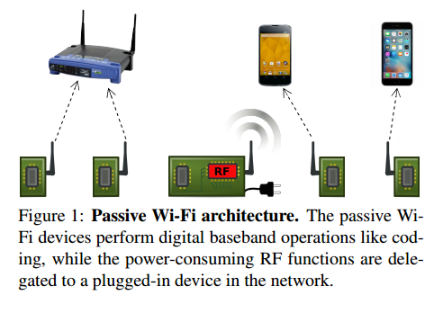
Passive Wi-Fi
http://passivewifi.cs.washington.edu/files/passive_wifi.pdf

Slide 21
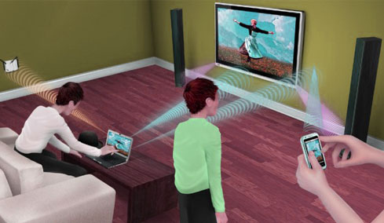
Gi-Fi
IEEE 802.15.3c
Millimeter wave communication
better data transfer rate with minimum power consumption
The subscriber station basically comprises of a small antenna that is mounted on the top in order to support the line of sight operations. In order to avoid any interference, it transmits multiples signals across the path of transmission, at the same time having different frequencies.
Future of 5G cellular networks and 5G mobile phones
Works without interference with existing technology
http://spectrum.ieee.org/telecom/wireless/millimeter-waves-may-be-the-future-of-5g-phones
http://www.loeacom.com/pdf%20files/L1104-WP_Understanding%20MMWCom.pdf

Slide 23
Terabit Satellite
Satellite Internet Communication
1Gbps of data transmission
Use satellite to communicate. There are gateways present that help in connecting with the internet
Convert phone to satellite phone using SatSleeve

Slide 24
Frequency, Range and Wavelength
Higher Frequency – Low Range, Low Wavelength – Less Penetration – Broader Bands and Higher Bitrate
Low Frequency – Higher Range, Higher Wavelength – High Penetration – Narrow Bands and Lower Bitrate

Slide 25
http://pubs.sciepub.com/jcn/4/1/3/

